Slide 1
General Exam: Committee Meeting
Kristian Eschenburg
Notes:
----- Meeting Notes (12/5/18 23:57) -----
Change title

Slide 2
Outline
Published and Other Projects
In Progress
Planned

Slide 3
Part 1: Published and Other Projects
Published
Connectivity-Driven Application of Cortical Maps to New Data
Other*
Analysis of Resting-State Dynamics Using DMD
Motion Correction Using CNNs
*See Appendix for slides

Slide 4
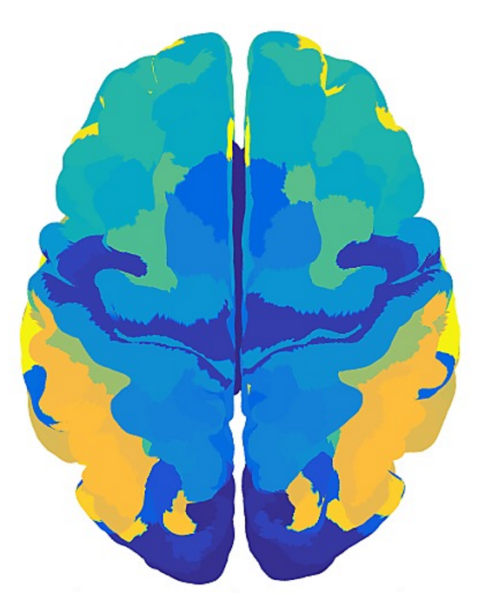
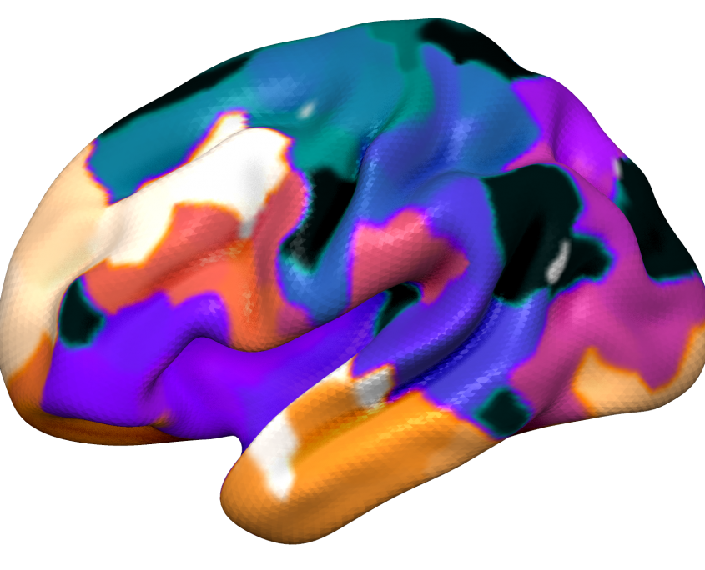
Applying Cortical Maps to New Data: Background and Motivation
Given a new MRI volume, would like to map cortical regions
Brodmann, Destrieux, Desikan-Killiany, AAL
Multi-modal maps (Glasser), or connectivity-based maps (Gordon)
Typically applied via surf./vol. registration
FreeSurfer
FSL (multimodal surface matching)
Notes:
Surface registration matches the cortical geometry well, but generally does not take into account other features
Exceptions are ANTS and MSM, which can include myelin density, curvature, thickness as features to drive the registration
After surface registration, give each point on the source volume cortex the label to which it maps in an atlas,
OR some maximum probability assignment if registered to a library of template images
This works well in generating new maps for subjects, but label assignments do no include connectivity information
Our hypothesis was that connectivity information, such as structural and functional connectivity features, should also drive the assignment of cortical labels to unlabeled points on the cortex

Slide 5
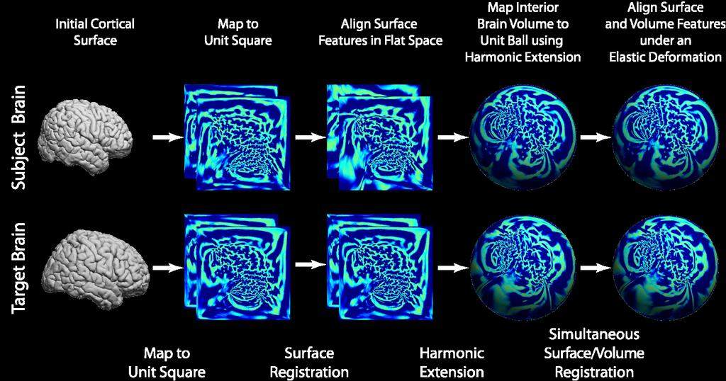
Applying Cortical Maps to New Data: Background and Motivation
Why not just keep using surface registration?
Labeling of voxel/vertex should reflect the underlying connectivity
Especially if interested in applying connectivity-derived maps (Glasser, Gordon, Arslan, Craddock, Fan)
Notes:
If interested in doing network connectivity analyses, labeling should reflect the underlying connectivity structure, so that you’re “comparing apples to apples”

Slide 6
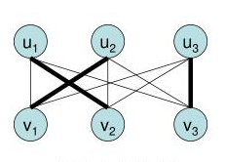
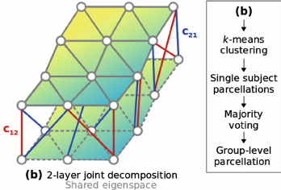
Applying Cortical Maps to New Data: Why not just re-run clustering algorithms?
Label matching
Max-weight bipartite matching problem
Utilize population Information
Arslan et al. treat problem as sub-space clustering
Notes:
For every run of a CBP algorithm, labeling is random – that is, the value assignments to each cluster are random
Left with the problem of having to “match” corresponding regions across subjects to identify homologous areas
Some methods make use of population information and propagate that information onto individual subjects
- Joint spectral clustering
----- Meeting Notes (12/5/18 23:57) -----
Reproducing Hilbert spaces? Project into an existing eigenspace

Slide 7
Applying Cortical Maps to New Data: Problem
How can we:
Reliably propagate connectivity-based maps to a new subject?
Take into account the unique connectivity profiles of that subject?
Idea:
Combine surface-registration with classification as a two-step process

Slide 8
Applying Cortical Maps to New Data: General Idea
Map all training brains to one another
For each label L, ID mis-matched labels, {M}
For each label, L, aggregate mismatched label data M_{d}
Training
Surface Registration
Label Aggregation
Train classifier, discriminate L from mismatched, M
Map test brain to all training brains
Compute label K to which vertex maps most frequently
Predict label of vertex using model K
Testing

Slide 9
Applying Cortical Maps to New Data: Data
HCP Data
Cortical surface mesh
HCP multi-modal cortical maps (Glasser) mapped to surface (training data)
Resting-state time series mapped to surface
Diffusion data

Slide 10
Applying Cortical Maps to New Data: Data
Classifier Features
Correlation matrix (N x N)
Probabilistic tractography streamline count matrix (N x N)
Aggregate (1 x N) vectors over FreeSurfer atlas regions → (N x (V = 75))
Connectivity to region instead of connectivity to surface points
Mesh-agnostic
Notes:
Surface registration matches the cortical geometry well, but generally does not take into account other features
Exceptions are ANTS and MSM, which can include myelin density, curvature, thickness as features to drive the registration
After surface registration, give each point on the source volume cortex the label to which it maps in an atlas,
OR some maximum probability assignment if registered to a library of template images
This works well in generating new maps for subjects, but label assignments do no include connectivity information
Our hypothesis was that connectivity information, such as structural and functional connectivity features, should also drive the assignment of cortical labels to unlabeled points on the cortex

Slide 11
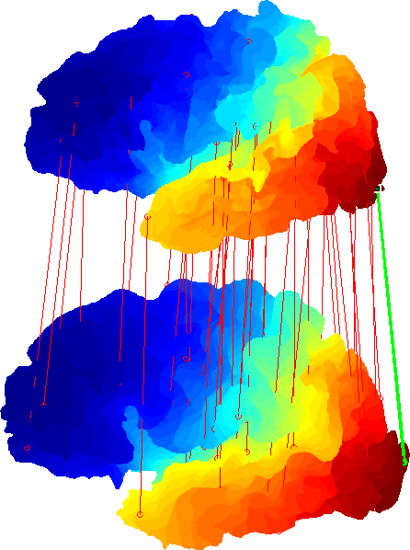
Applying Cortical Maps to New Data: Surface Registration
Compute pairwise registrations between training brains (Lombaert, 2013)
Compute frequency with which each label maps to all other labels
Register test brain to all training brains
Compute frequency with which test vertex maps to each label
Notes:
For the training data, compute the registration between all pairs of surfaces
For each label in the training set, compute the probability with which that label maps to all other labels
Use non-zero probability labels as the classifier search space. Generate 180 classifiers (1 per label, where classes are the search space generated via training surface registration)
For a test brain vertex, compute set of labels it maps to. Choose most frequently mapped to label – use this classifier
Compute intersection of mapping sets (red and blue) and use these frequencies to weight classifier probabilities

Slide 12
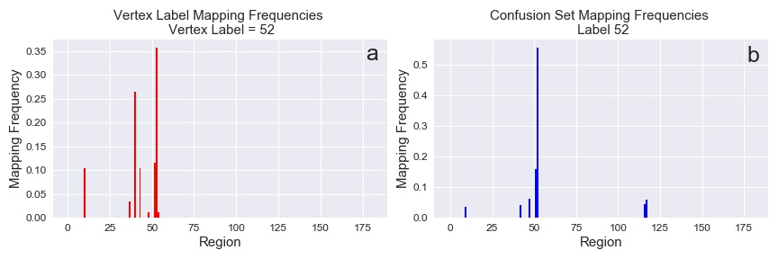
Applying Cortical Maps to New Data: Surface Registration
Use registration to constrain set of possible labels to assign to cortical point
Notes:
For the training data, compute the registration between all pairs of surfaces
For each label in the training set, compute the probability with which that label maps to all other labels
Use non-zero probability labels as the classifier search space. Generate 180 classifiers (1 per label, where classes are the search space generated via training surface registration)
For a test brain vertex, compute set of labels it maps to. Choose most frequently mapped to label – use this classifier
Compute intersection of mapping sets (red and blue) and use these frequencies to weight classifier probabilities

Slide 13
Applying Cortical Maps to New Data: Classification
Generate as many classifiers as there are training labels
Training features = connectivity vectors for “confusion set”
Training labels = labels for “confusion set”
Testing features = connectivity vector of test vertex

Slide 14
Applying Cortical Maps to New Data: Classification Models
Tested 3 classifiers
Random Forests
GMM
Neural Network
Additional parameters
Includes / Exclude registration mapping frequencies
Weight classifier probabilities

Slide 15
Applying Cortical Maps to New Data: Classification Performance Metrics
Regional Homogeneity
How similar are connectivity profiles within regions?
Accuracy
How closely do predicted maps resemble the held-out maps?
Again, tried to predict HCP Glasser maps

Slide 16
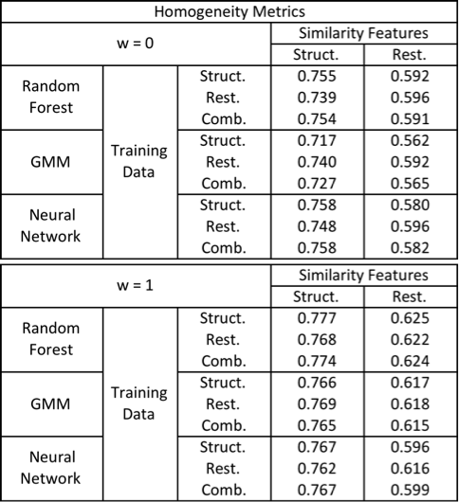
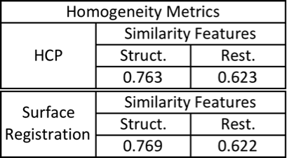
Applying Cortical Maps to New Data: Regional Homogeneity
Models
Ground Truth vs.
SurfReg Only
Random forest marginally improves homogeneity
only when including mapping frequencies
GMM / Neural Network similar or lower homogeneity than original and and SurfReg-only
Notes:
Computed homogeneity as the mean intra-regional feature correlation for all regions within a given map, averaged across subjects
expect Surface registration to have similar homogeneity to training maps
Although marginal, lends evidence to the idea that HCP maps do not BEST explain connectivity features, if we can improve upon the homogeneity

Slide 17
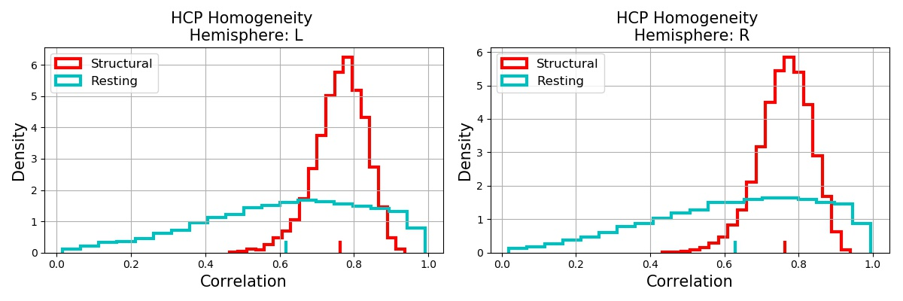
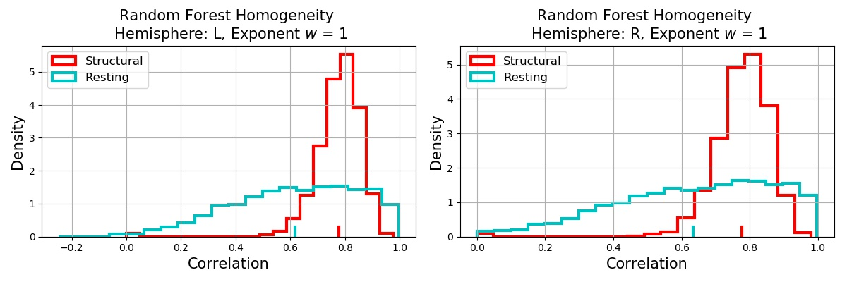
Applying Cortical Maps to New Data: Regional Homogeneity
Homogeneity distributions of original maps vs. Random Forest maps
Of interest:
rs-fMRI homogeneity more variable than dMRI features
Notes:
Computed homogeneity as the mean intra-regional feature correlation for all regions within a given map, averaged across subjects
expect Surface registration to have similar homogeneity to training maps
Although marginal, lends evidence to the idea that HCP maps do not BEST explain connectivity features, if we can improve upon the homogeneity

Slide 18
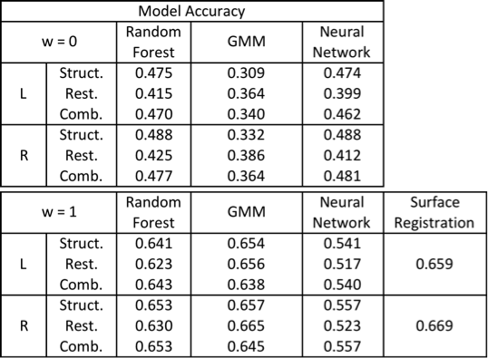
Applying Cortical Maps to New Data: Accuracy
Compare predicted maps to same-subject held-out HCP maps
Expectation: SurfReg would have highest accuracy
No reason to believe that connectivity features should replicate maps computed on different data
Connectivity should reflect individual variability

Slide 19
Applying Cortical Maps to New Data: Summary
Approach offer new way to apply existing cortical maps to new images, by incorporating connectivity data
Slight evidence that regional homogeneity improves over surface registration using Random Forests
Highly model-dependent
Maps should incorporate individual variability AND population average
Eschenburg, K. Haynor, D., Grabowski, T. Automated Connectivity-Based Cortical Mapping Using Registration-Constrained Classification. Medical Imaging, 2018.

Slide 20
Applying Cortical Maps to New Data: (Possible) Future Work
Use patch-based label-fusion based approach (Coupe 2011, Asman 2013, Wu 2014, Liu 2015)
Using surface registration, compute similarity of test vertex to local regions of target vertex
Weight contribution of targets by similarity

Slide 21
Part 2: Current Project
Connectivity-based parcellation of the IPL to identify sub-regions of the IPL
Of specific interest: PGa and PGp
Analyze model performance
Compare clusters to known histological partitions
Identify Sub-Regions Corresponding to Resting-State Networks
Notes:
Sensorimotor network (SMN), Salience Network (SN), Executive Control Network (ECN), Default Mode Network (DMN)

Slide 22
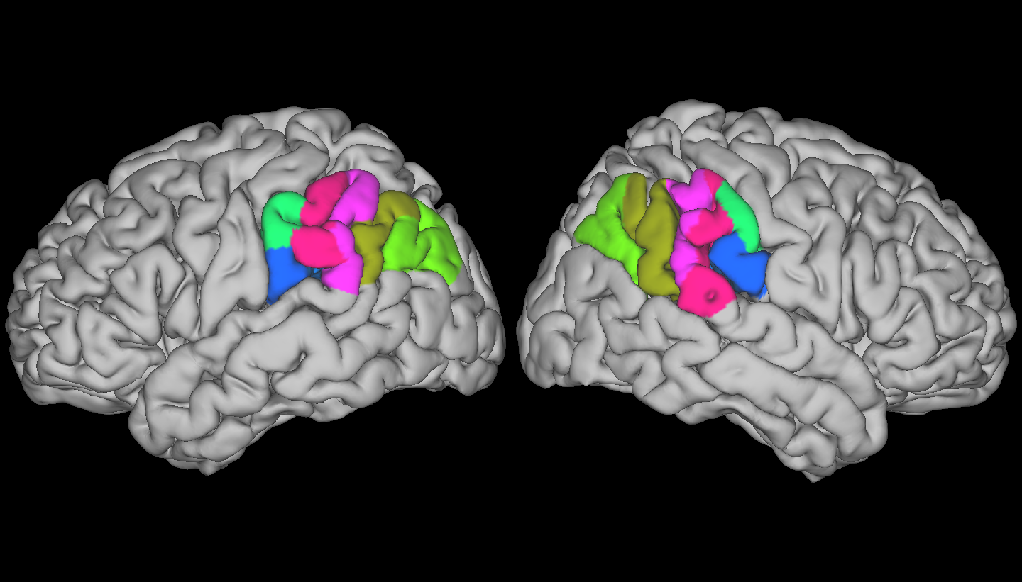
CBP of Inferior Parietal Lobule: Motivation
NSF Grant
Identify PGa and PGp using CBP w/ fMRI and dMRI
Hypothesis:
cognitive effects of knockdown of PGa/PGp using TMS related to sub-region size and connection profiles
Notes:
PGa and PGp are the two most posterior sub-regions of the IPL as defined by the Casper’s probabilistic histological atlas
Identified using multivariate approach based on Mahalanobis distance between feature vectors describing each cortical region (Schleicher 2009)
PGa located on the angular gyrus and extends into the inferior parietal sulcus, shares caudal border with PGp
PGp does not extend to the Sylvian fissure

Slide 23
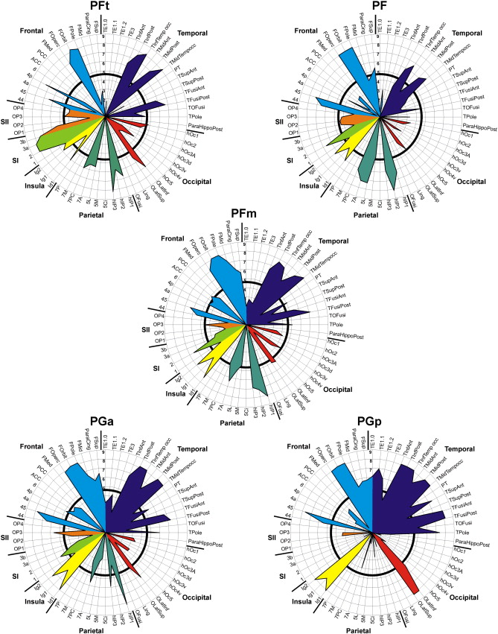
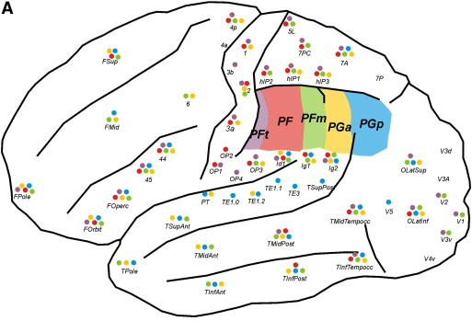
CBP of Inferior Parietal Lobule: Background
Caspers, 2011
Differential dMRI connectivity fingerprints
Smooth transitions between sub-regions

Slide 24
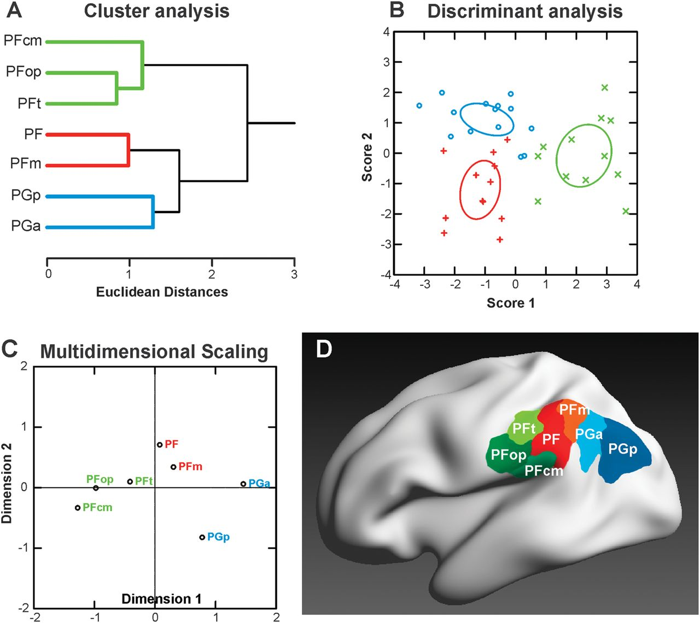
CBP of Inferior Parietal Lobule: Background
Caspers, 2012
Receptor architectonics
Of interest:
Nested sub-structure based on receptor density
Encourages use of clustering algorithms that can explore this nested structure (e.g. SBMs)

Slide 25
CBP of Inferior Parietal Lobule: Background
Wang, 2015
Sub-regional IPL network disruptions in AD
Increased DMN connectivity in both PGa / PGp
Hypothesized that this was compensatory
Uddin, 2010
Differential structural and functional connectivity of PGA, PGp
Fronto-Parietal vs. Default Mode
Notes:
Sensorimotor network (SMN), Salience Network (SN), Executive Control Network (ECN), Default Mode Network (DMN)

Slide 26
CBP of Inferior Parietal Lobule: Background
Wang 2016, Wang 2017
dMRI – 5 sub-regions
rs-fMRI and co-activation – 7 sub-regions
Notes:
Wang et al.
Identified 5 subregions using dMRI and 7 subregions using resting-state

Slide 27
CBP of Inferior Parietal Lobule: Approaches
Cluster connectivity
dMRI vs. [dMRI, rfMRI]
Examine relationship w/ Caspers and Juelich atlases
Examine relationship w/ resting-state networks

Slide 28
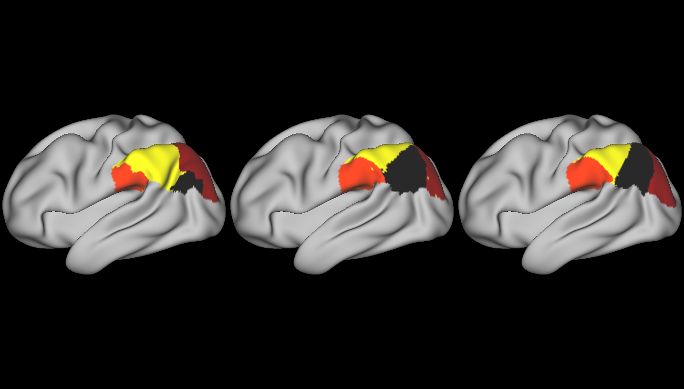
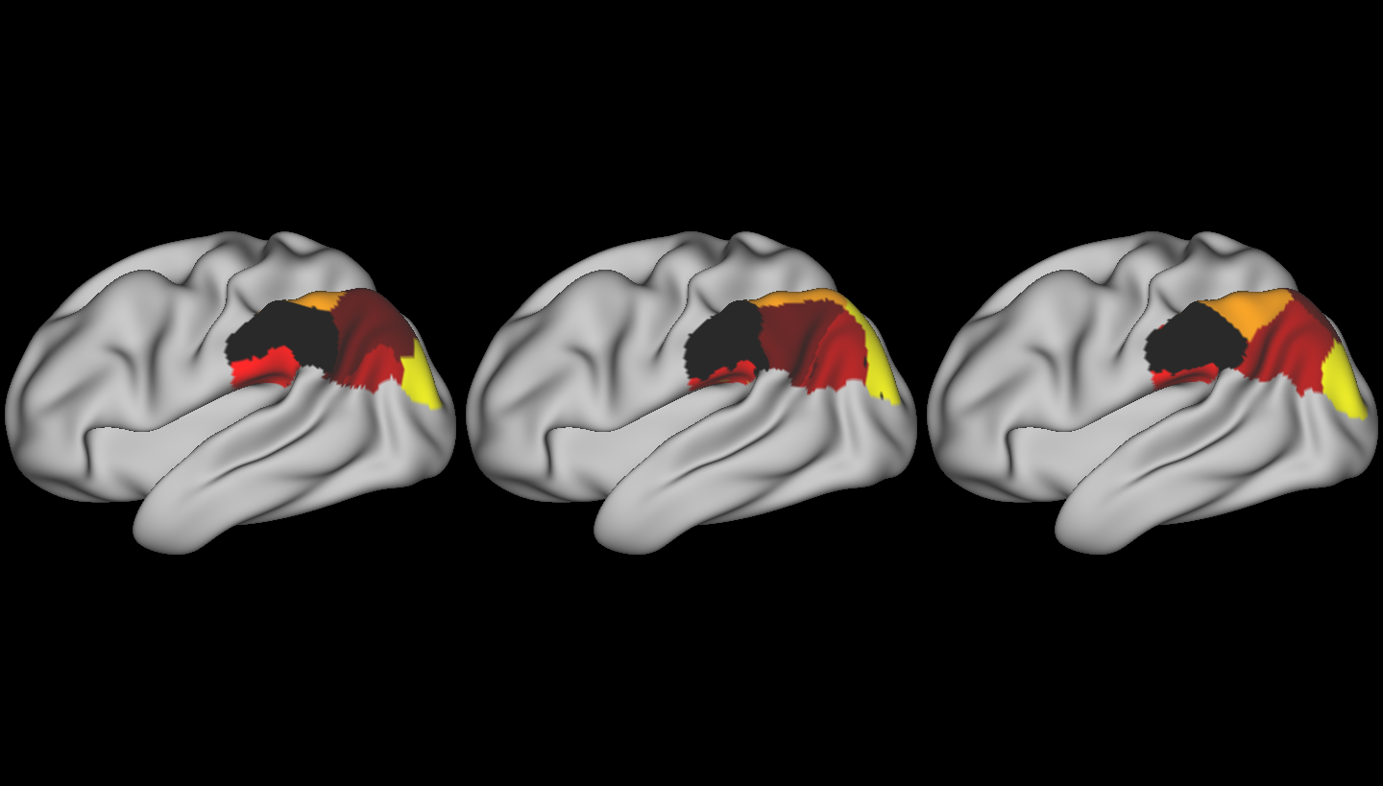
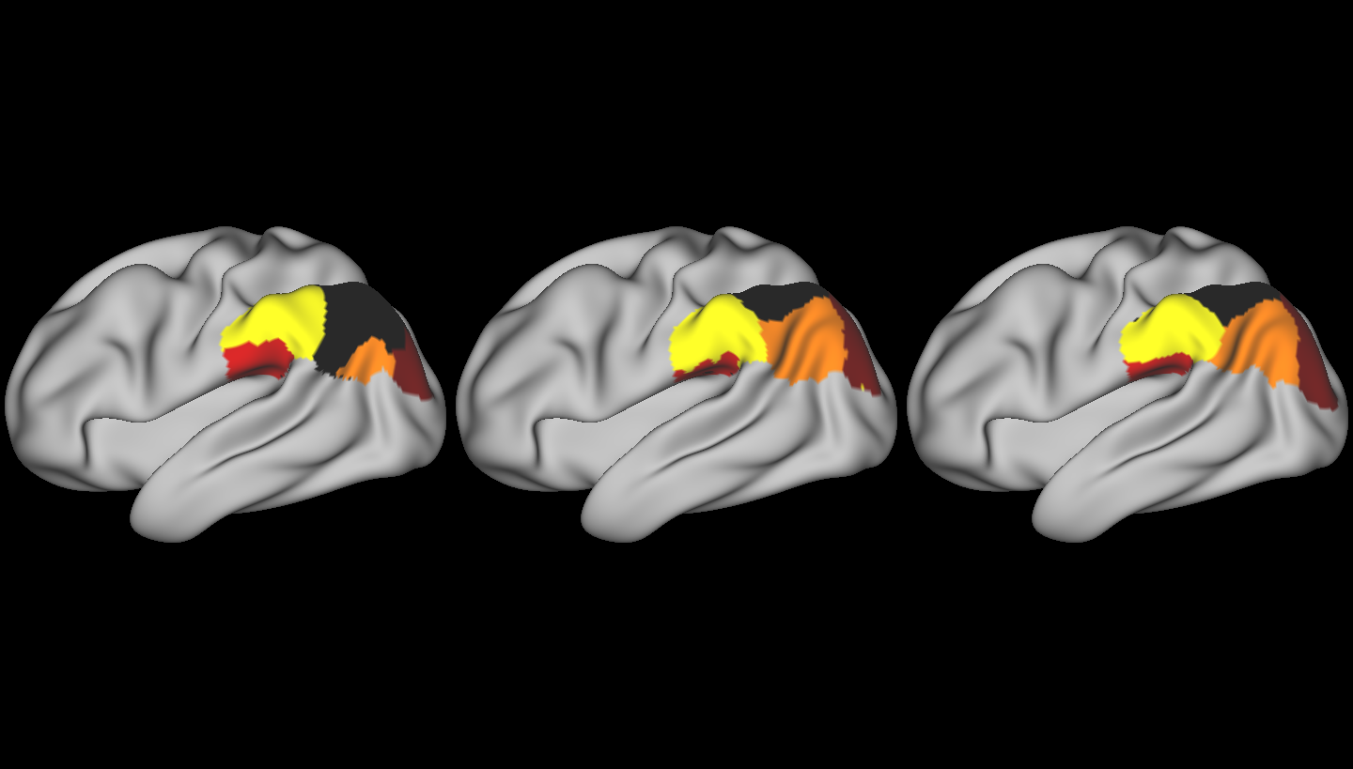
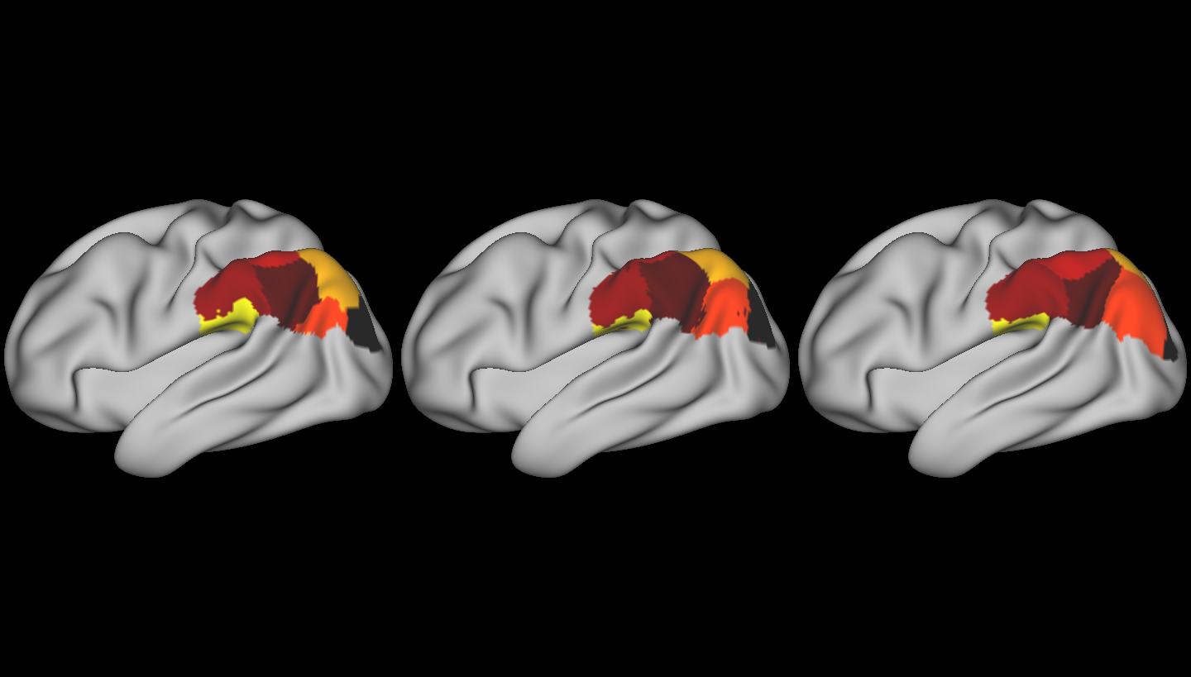
CBP of Inferior Parietal Lobule: Spectral Clustering
Subj. 1
Subj. 2
Subj. 3
Subj. 1
Subj. 2
Subj. 3
Juelich IPL
4
6
5
7
Notes:
Only just received the Juliech atlas surface maps 2 days ago from Mohlberg – have not yet had a chance to compare borders / connectivity profiles

Slide 29
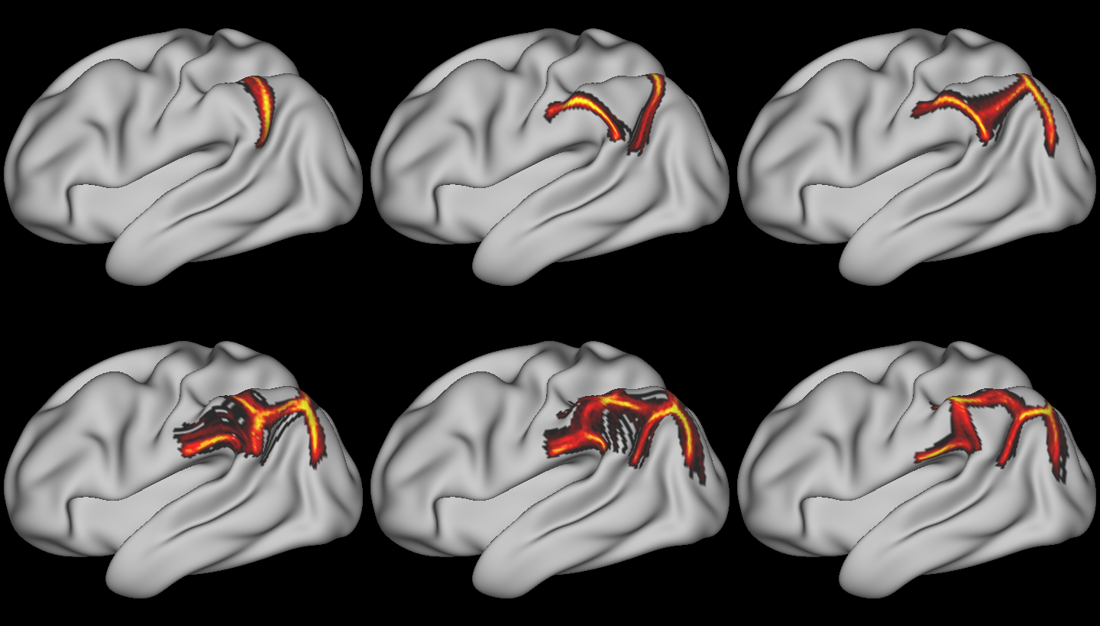
CBP of Inferior Parietal Lobule: Spectral Clustering
2
3
4
Empirical probability of vertex existing at cluster border
Cluster borders show high-degree of overlap
5
6
7
Notes:
Wang et al.
Identified 5 subregions using dMRI and 7 subregions using resting-state

Slide 30
CBP of Inferior Parietal Lobule: ddCRP
Distance-Dependent Chinese Restaurant Process (ddCRP)
non-parametric clustering model that learns the number of clusters
C : linkages between samples (implicit cluster labels)

Slide 31
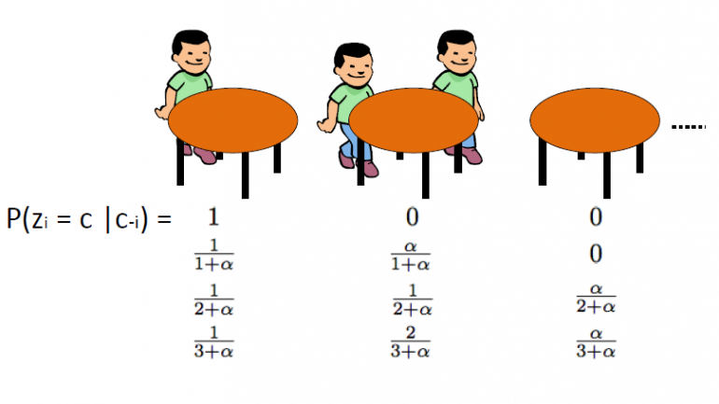
CBP of Inferior Parietal Lobule: ddCRP
Algorithm
Initialize parcellation (e.g. Ward)
Iterate over voxels / vertices
Options:
Stay in current cluster
Join (other) existing cluster
Create new cluster
Gibb’s sampling
Notes:
At each iteration, a sample has the opportunity to stay in the current cluster its in, join a different cluster or create a new cluster
Each of these are chosen with probability according to how the log-probability of the whole parcellation changes if that option is picked, via Gibb’s sampling

Slide 32
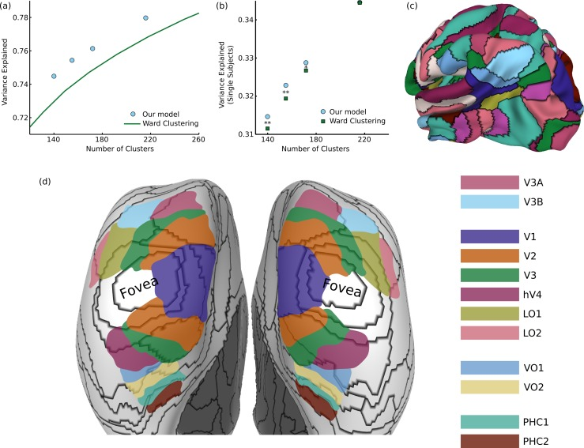
CBP of Inferior Parietal Lobule: ddCRP
(Baldassano, 2015) modeled similarities in an affinity matrix
Here, we model the feature vectors themselves

Slide 33
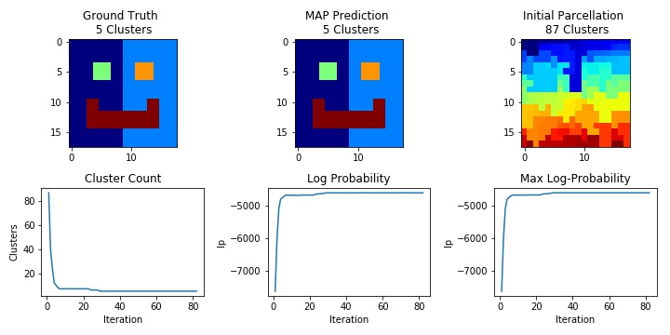
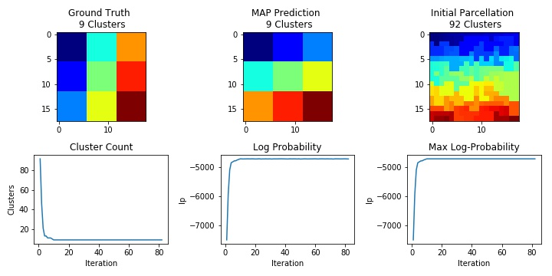
CBP of Inferior Parietal Lobule: ddCRP
ddCRP
Model performs well on synthetic data
quickly learns number of clusters

Slide 34
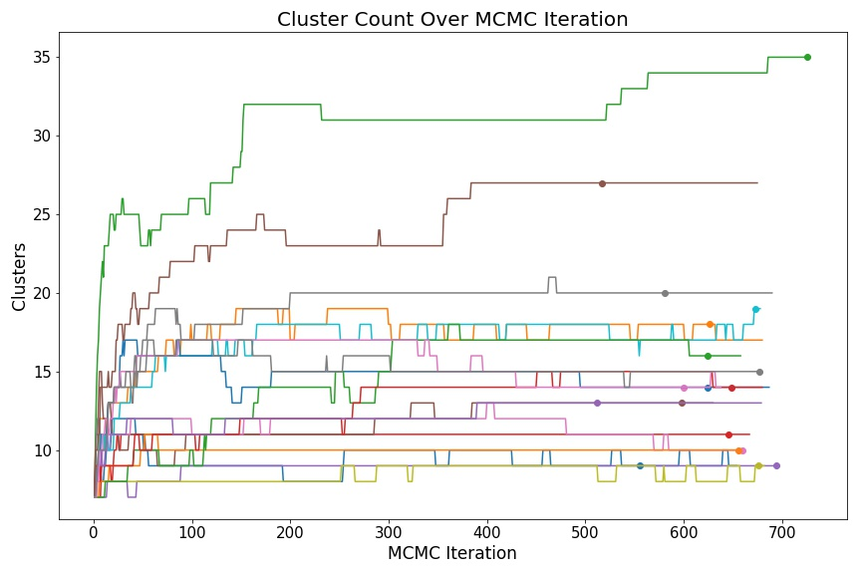
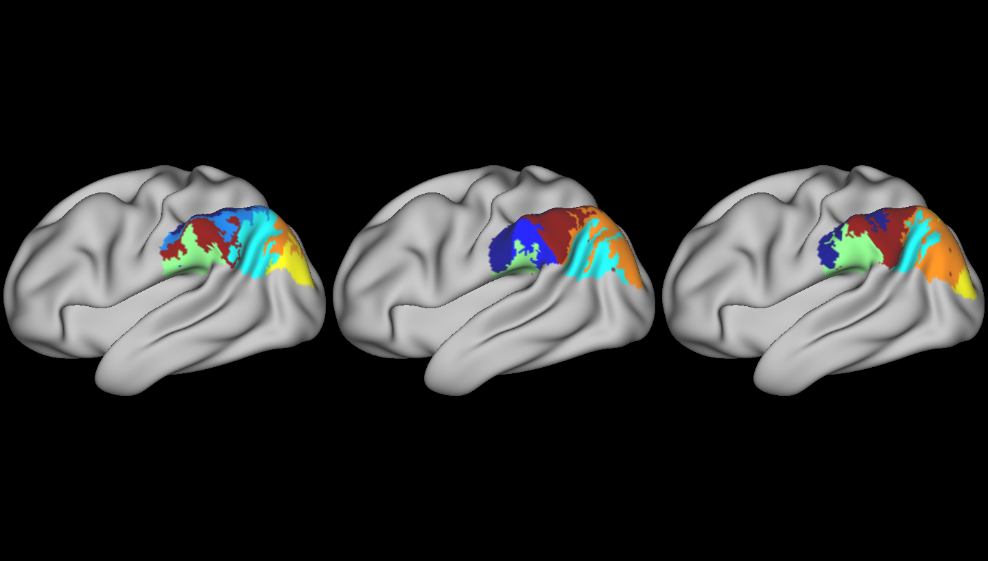
CBP of Inferior Parietal Lobule: ddCRP – Very Preliminary
Constant hyperparameters results in large variability in number of clusters
Map that maximizes log-probability specified by *

Slide 35
CBP of Inferior Parietal Lobule: ddCRP Next Steps
How to choose hyper-parameters?
Optimize on a subject-by-subject basis?
More iterations?
Label that maximizes log-probability at tail end of MCMC iterations
Mixing distribution might not be stationary yet

Slide 36
CBP of Inferior Parietal Lobule: Fiber Tracking Problem
Issues with fiber tracking
Low diffusion signal at gray/white interface
High preference for hyper-short range connections
Clustering driven by short-range instead of long-range fibers
Idea:
Use inward-projected surface (St-Onge and Descoteaux, 2017)
Constrain initial tracking direction

Slide 37
CBP of Inferior Parietal Lobule: Fiber Tracking Problem
Why not just seed from white matter?
Un-equal sampling of cortex
Can’t parameterize each cortical point w/ # of fibers
Streamlines tend to “hop” onto major white matter bundles

Slide 38
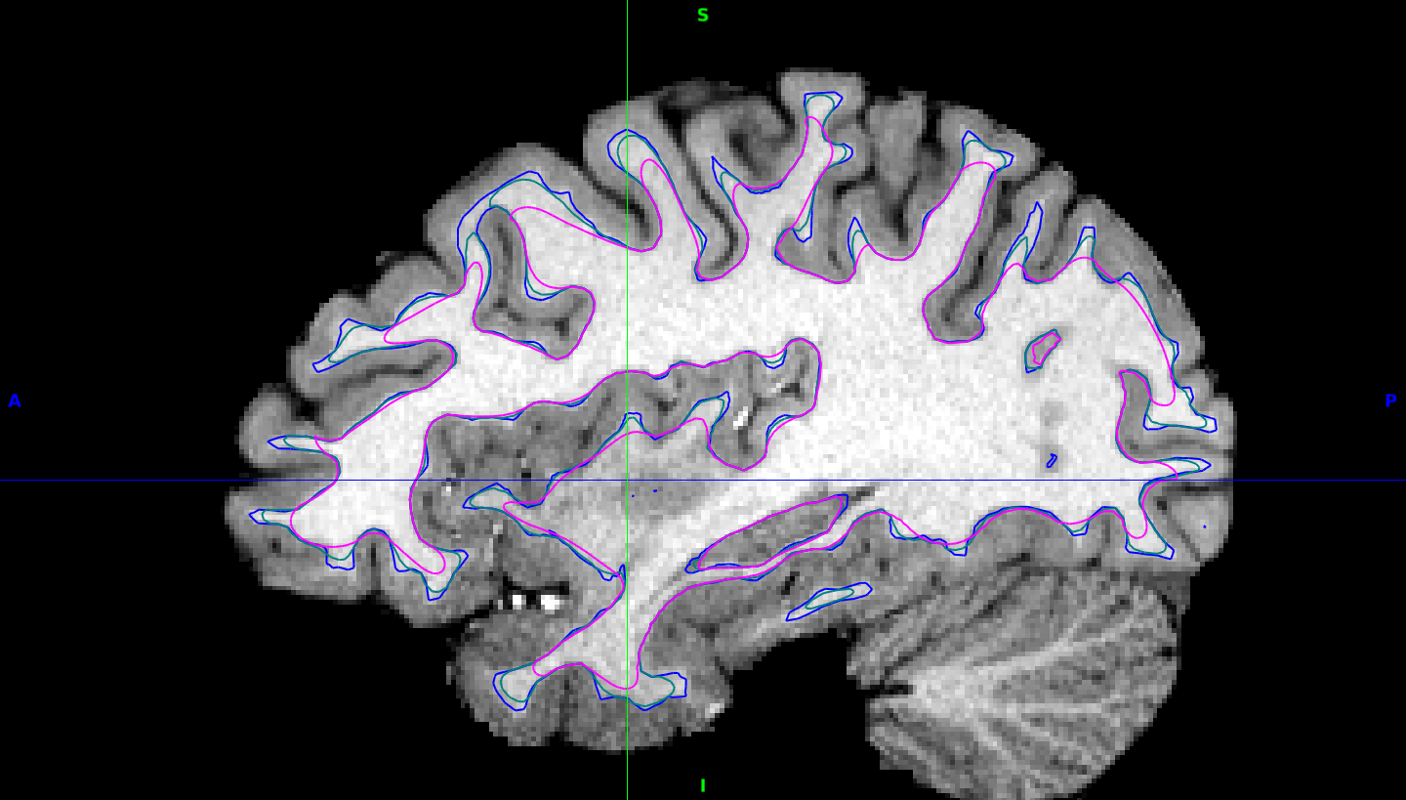
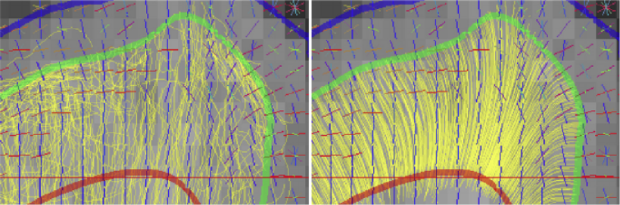
CBP of Inferior Parietal Lobule: Improving Tractography
Curvature flow of G/W surface
Project surface inwards
Minimize mean curvature
Seed fibers from flow surface
Gray/White
Curvature flow surface

Slide 39
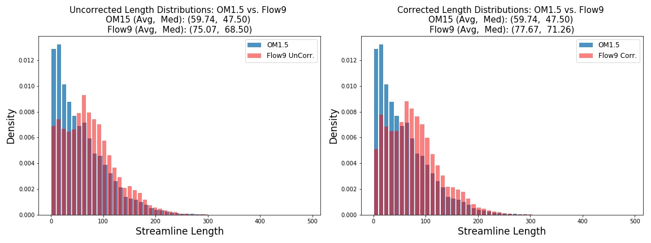
CBP of Inferior Parietal Lobule: Streamline Length Distributions
Add back length of curvature line (right figure)

Slide 40
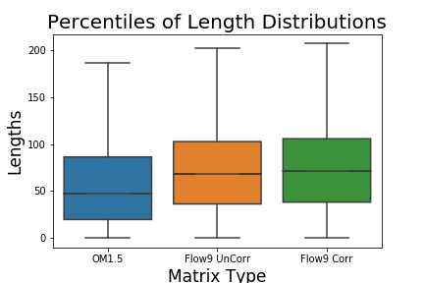
CBP of Inferior Parietal Lobule: Improving Tractography
Original problem
Low diffusion signal → preference for short fibers
Clustering driven by local / short association fibers
Notes:
What have we done to fix these problems
Modify probtrackx2 to accept new surface
Add check for inward / outward flow
Enforce initial tracking direction

Slide 41
CBP of Inferior Parietal Lobule: Improving Tractography
What have we fixed?
Modify probtrackx2 to accept new surface
Check for inward / outward curvature flow
Enforce initial tracking direction
Importance
Still sample U-fibers
Sample long-association fibers more
Remove preference for hyper-short connections

Slide 42
CBP of Inferior Parietal Lobule: Next Steps
Cluster IPL w/, w/o curvature-corrected tractography
Compare ICA components to clustered tractography
Identify cluster that corresponds to DMN and LFP networks
Validate method with other known histological maps
Frontal Pole (Bludau, 2014)
BigBrain (Amunts, 2013)

Slide 43
Part 3: Planned Projects
Analyze Relationship Between Resting-State- vs. Diffusion-derived parcels
Cluster both data-types using single paradigm?
Analyze Fine-Scale Spatial Connectivity Gradients
“Connectopy”

Slide 44
Relationship Btw. Struct and Func: Prior Work
Limited prior work comparing parcellations
Spatial overlap of parcels
Regional homogeneity (Shi, 2007)
Compare network topology (Sporns, Honey)
Regress FC on SC as function of network size (Sporns, Honey)
Notes:
Cortical Field Hypothesis
All neurons and synapses within an area perform co-operative computation
Cortical Field Activation Hypothesis
WEAK: Neurons in cortex change biochemical activity in large distinct ensemble
What is the resolution of these behavioral changes?
Begs the questions of – HOW MANY REGIONS ARE THERE
Only says that the field if the largest functional region
STRONG:

Slide 45
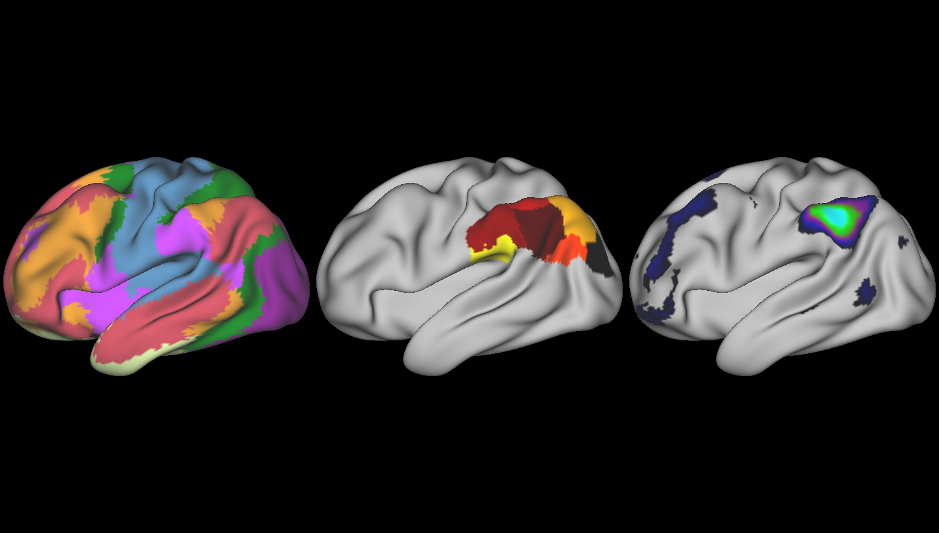
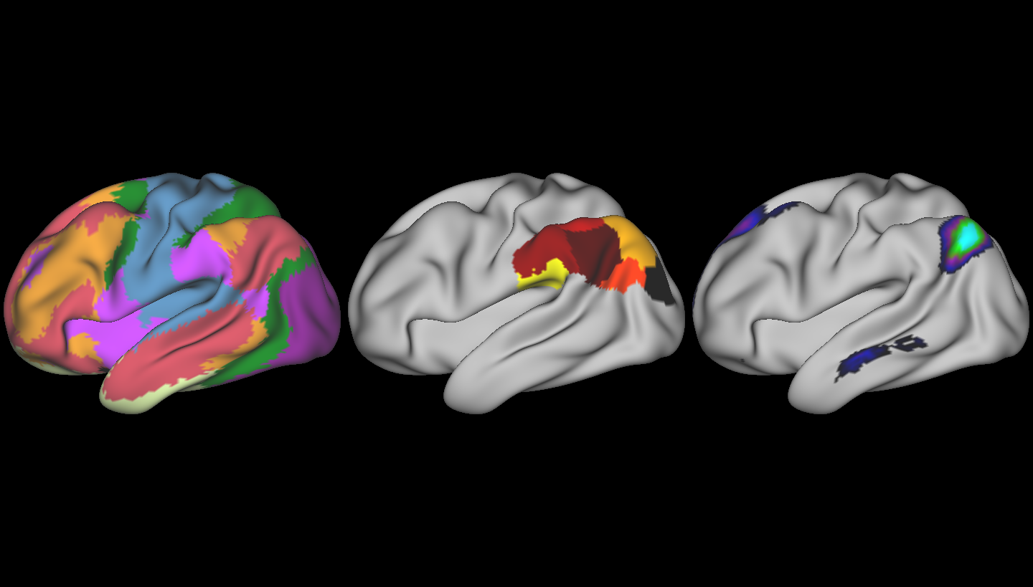
Relationship Between Structural and Functional Parcellations
rs-fMRI-weighted structural connectivity
Compute ICA components
Calculate probability that cortical vertices / voxels belong to same component
Probability can be factored into affinity matrix or into ddCRP Gibb’s sampling
Lateral Front-Parietal
Default Mode
Notes:
By incorporating the ICA network probabilities into the model (whatever the model happens to be), we are informing structural-connectivity derived parcellations using resting state network membership
The features themselves form a local similarity measure i.e. clusters are compact, so local similarity defined by the cluster neighbor of a vertex, but the ICA networks span the whole brain, so act as a non-local source of information
Merging both local and non-local information from both the

Slide 46
Analysis of Fine Scale Connectivity Gradients
Recent interest in “connectopies”
Spatial gradients in connectivity profiles (Haak 2017)
Given affinity matrix, W, compute Laplacian
Gradients then defined by eigenvectors of L
Notes:
Cortical Field Hypothesis
All neurons and synapses within an area perform co-operative computation
Cortical Field Activation Hypothesis
WEAK: Neurons in cortex change biochemical activity in large distinct ensemble
What is the resolution of these behavioral changes?
Begs the questions of – HOW MANY REGIONS ARE THERE
Only says that the field if the largest functional region
STRONG:

Slide 47
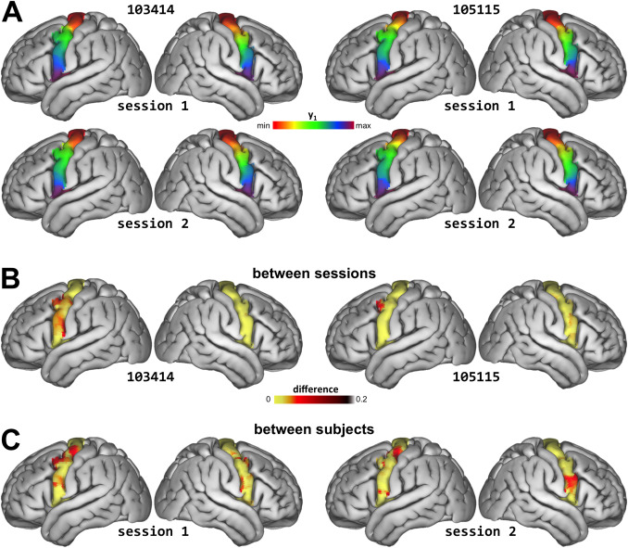
Analysis of Fine Scale Connectivity Gradients
Haak 2017
Compute regional connectivity gradients
Make inference over gradients:
Fit polynomial basis functions for trends
Fit Gaussian-Process for fine-scale variations
Model coefficients allow for population inference
Notes:
Cortical Field Hypothesis
All neurons and synapses within an area perform co-operative computation
Cortical Field Activation Hypothesis
WEAK: Neurons in cortex change biochemical activity in large distinct ensemble
What is the resolution of these behavioral changes?
Begs the questions of – HOW MANY REGIONS ARE THERE
Only says that the field if the largest functional region
STRONG:

Slide 48
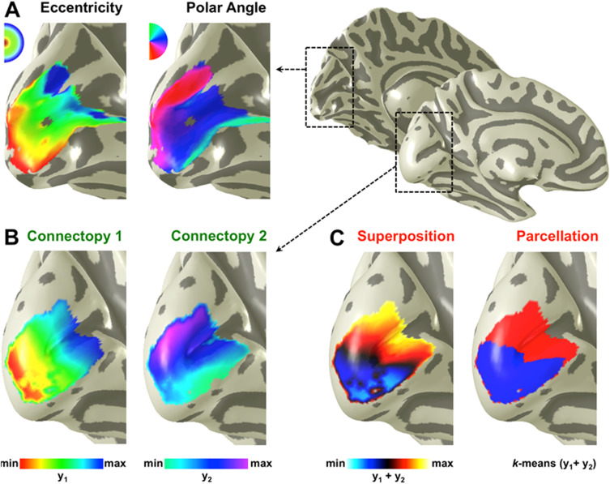
Analysis of Fine Scale Connectivity Gradients
Haak 2017
Comparison of connectopy of V1 to retinotopy of V1
Reason to believe that connectopy can shed light on “retinotopic”-like connectivity patterns for whole cortex
Notes:
Cortical Field Hypothesis
All neurons and synapses within an area perform co-operative computation
Cortical Field Activation Hypothesis
WEAK: Neurons in cortex change biochemical activity in large distinct ensemble
What is the resolution of these behavioral changes?
Begs the questions of – HOW MANY REGIONS ARE THERE
Only says that the field if the largest functional region
STRONG:

Slide 49
Analysis of Fine Scale Connectivity Gradients: Idea
Given single pair-wise connectivity matrix between two regions, R1 and R2
Compute
M is set of (not necessarily unique) samples in region R2 to which samples in region R1 connect most strongly

Slide 50
Analysis of Fine Scale Connectivity Gradients: Idea
Compute multivariate linear relationship between spatially embedded source (R1) and target (R2) coordinates
where p = dim(basis set) + 1
Affine mapping between source and target points with maximum connectivity
A matrix describes the the linear relationship between pairwise connection profiles, over which we can make population inference

Slide 51
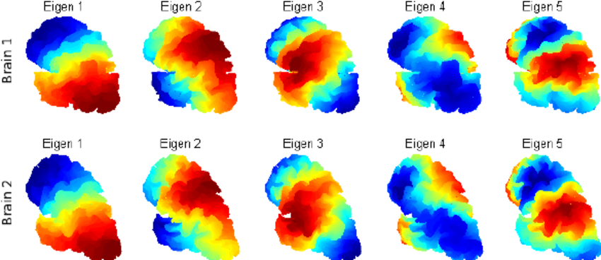
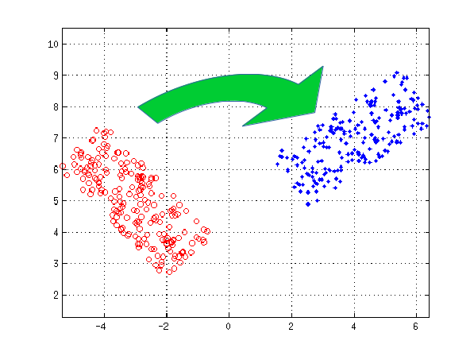
Analysis of Fine Scale Connectivity Gradients: Idea
Basis set is variable
3D Euclidean spatial coordinates
Laplacian eigenfunctions
Regional connectopies
Spherical coordinates transforms
End goal is to measure pairwise, linear relationship of connection strengths between region pairs

Slide 52
Analysis of Fine Scale Connectivity Gradients: Hypothesis
Goal is to measure the pairwise, linear relationship of connectivity between pairs of regions, in similar fashion to retinotopic studies
Based on V1/V2 organization, can we find pairs of regions that have analogous organization patterns?

Slide 53
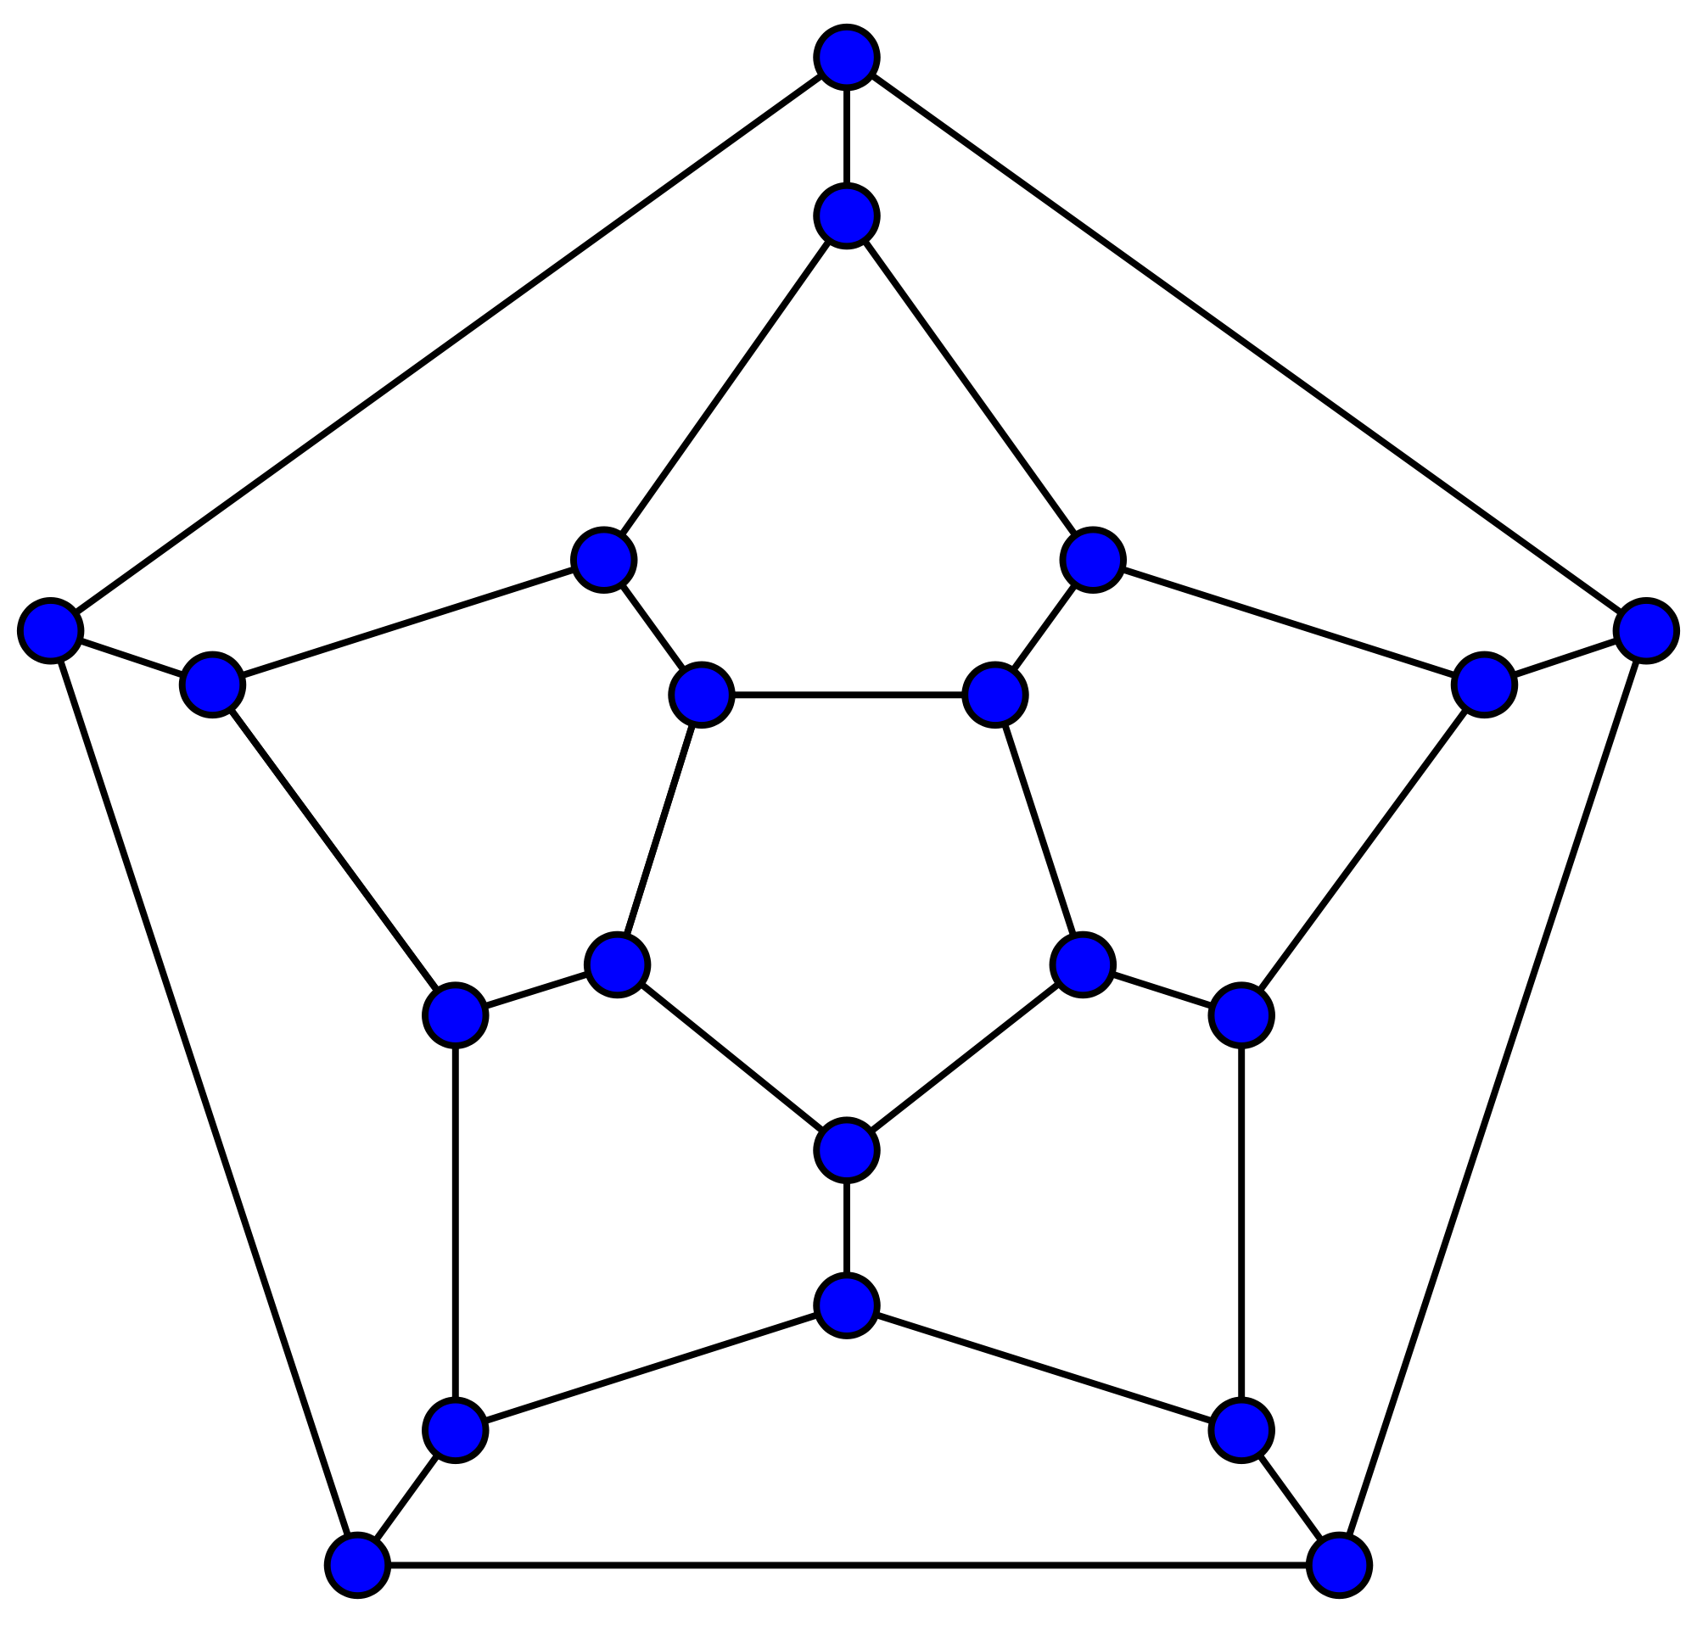
Analysis of Fine Scale Connectivity Gradients: Hypothesis
Can boil down pairwise relationship to single scalar value
Explained variance
Randomness using MI
Analyze network topology described by these organizational measure
More fine-tuned than typical graph theory measures

Slide 54
Appendix: DMD
Analysis of Resting-State Dynamics Using DMD
DMD is a modal decomposition algorithm that retains both frequency and time information
Kunert-Graf, J., Eschenburg, K., Galas, D., Kutz, N. Rane, S., Brunton, B. Extracting Time-Resolved Resting-State Networks Using Dynamic Mode Decomposition. BioRxiv. 2018. (in revision).
https://kristianeschenburg.github.io/2018/05/dynamic-mode-decomposition-part-1

Slide 55
Appendix: DMD
Analysis of Resting-State Dynamics Using DMD
Goal of project was to:
1. Develop methodology of applying DMD to resting-state data
2. Compare ability of DMD against ICA to identify RSNs
3. Analyze dynamics of RSNs

Slide 56
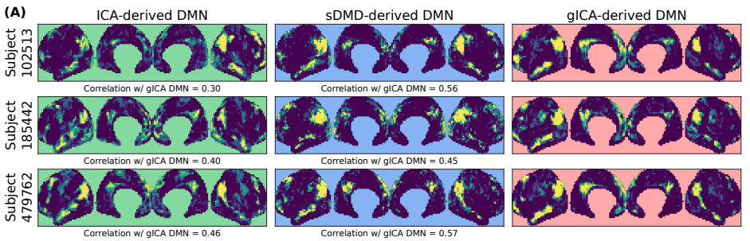
Appendix: DMD
Single-Subject DMD (sDMD) can reliably extract RSNs

Slide 57
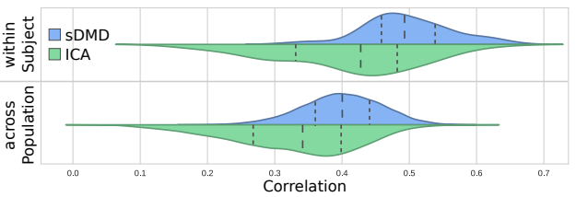
Appendix: DMD
sDMD RSN modes have higher spatial correlation with gICA modes, without need to “share” information across subjects

Slide 58
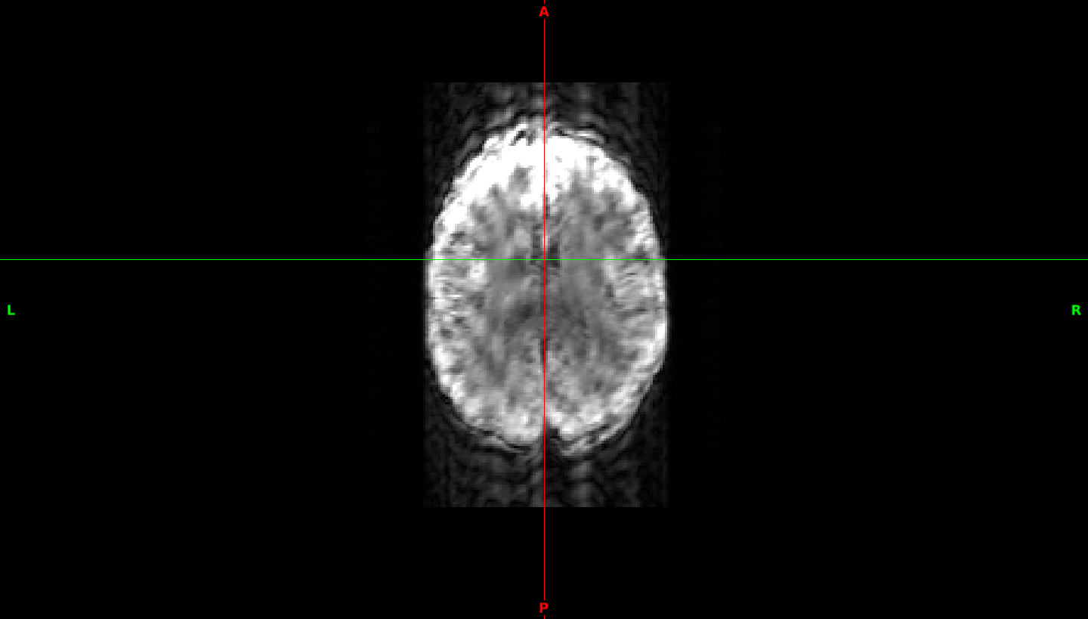
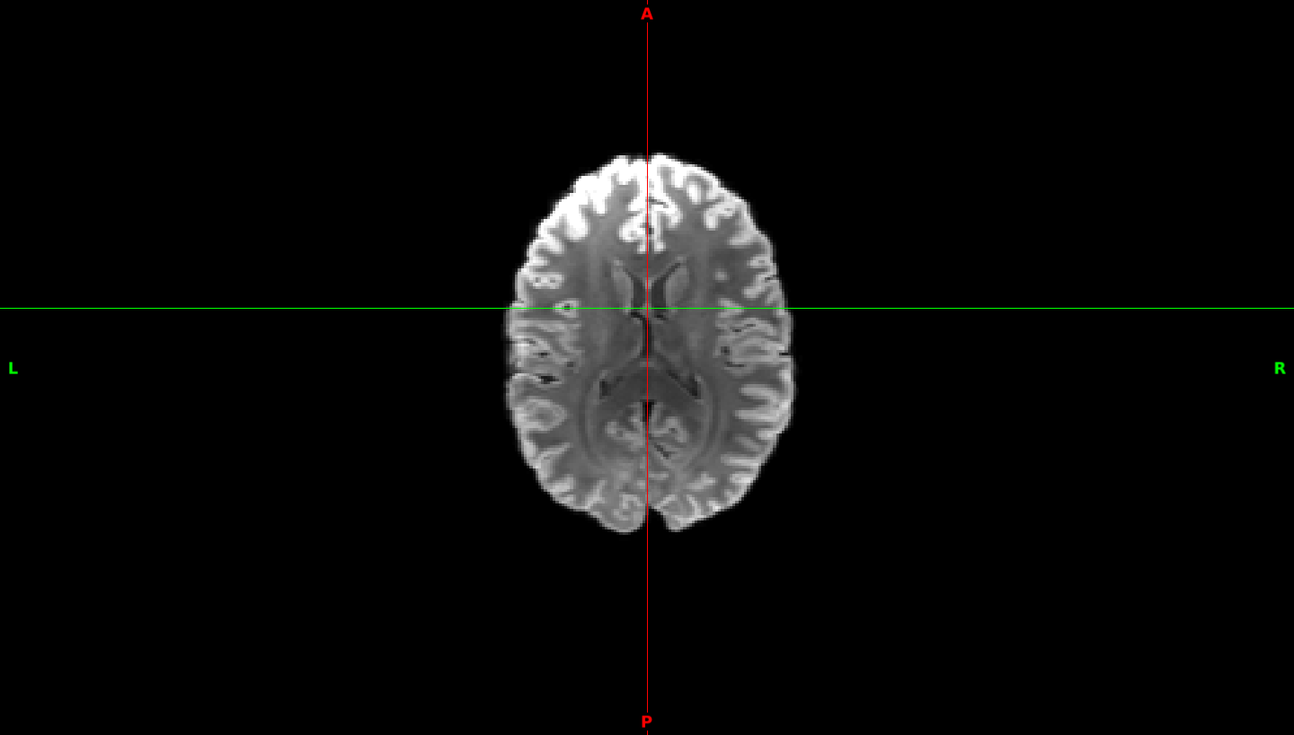
Appendix: Motion Correction Using CNNs
Motion-Correction with Convolutional Neural Networks
Given motion-corrupted T1, T2, or DWI, can we remove the motion artifacts?
?

Slide 59
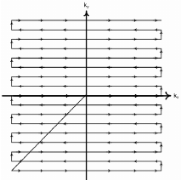
Appendix: Motion Correction Using CNNs
Motion / Motion-free rescan data is hard to come by
Designed method to simulate 2D motion by applying shifts in K-space during rectilinear trajectory
FFT 2D slice
Apply (+/-) patient motion in X/Y plane – manifests as shift of trajectory in X/Y plane
iFFT 2D slice w/ added motion

Slide 60
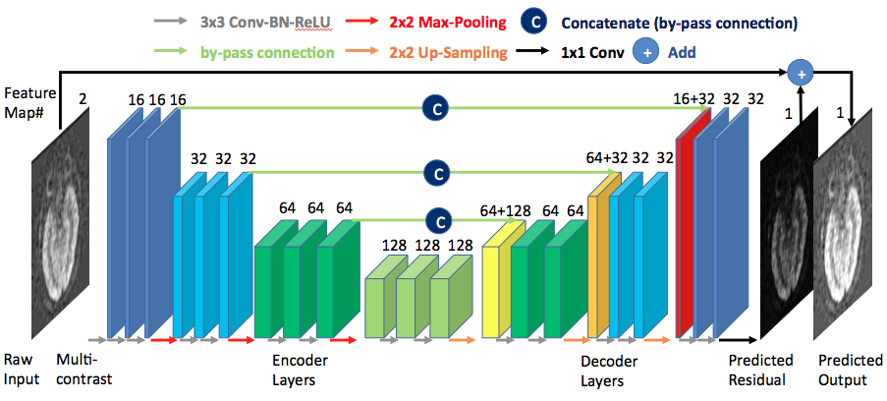
Appendix: Motion Correction Using CNNs Network Structure
Gong, E., et al. Deep Learning Enables Reduced Gadolinium Dose for Contrast-Enhanced Brain MRI. 2018

Slide 61
Appendix: Motion Correction Using CNNs
Preliminary results based on too-low sample size
Simulating motion in HCP T1, T2, and DWI B0s
Testing different loss functions
Would appreciate feedback an more accurate / realistic ways to simulate motion

